Slide 1
Infectious Bronchitis (IB) is a viral disease affecting chickens of
all ages worldwide.
IB … Host Affinity
IB affects chickens of all ages.
They are the only species reported to be naturally affected.
Infectious Bronchitis virus (IBV) targets:
Respiratory tract
Urogenital tract

Slide 2
Infectious bronchitis
IB is highly contagious.
The incubation period is relatively short, 18 - 36 hours.
Disease spreading through an entire flock within one or two days

Slide 3
Avian infectious bronchitis virus (IBV), a coronavirus (Coronaviridae, genus Gammacoronavirus, .
• Different serotypes (Respiratory, Nephrotoxic)
o Respiratory tract - massachusetts and connecticut
o Nephrotoxic - T, Gray and Holte
• Concurrent infection with more than one serotype occurs

Slide 4
IBV causes:
Respiratory disease in the infected birds.
Drops in egg production in layers and breeders.
False layers.
Kidney damage can also occur.

Slide 5
IB clinical forms
1. Infection of respiratory tract.
2. Infection of the oviduct of: 1. Immature birds, leading to permanent damage.
2. Laying hens, leading to:
1. Cessation of egg-laying , sudden drop in egg production.
2. Production of thin-walled and misshapen shells with loss of shell pigmentation.

Slide 6
Infection of the urinary system
IB can be nephropathogenic causing acute nephritis and urolithiasis (Cavanagh & Gelb, 2008).
After apparent recovery, chronic nephritis can lead to death at a later time.
IBV has also been reported to produce disease of the proventriculus

Slide 7
transmission
The IB virus spreads horizontally by: 1. Aerosol transmission (sneezing)
2. Contaminated organic material, drinking water &equipments
Vertical transmission (from the hen to their progeny through the egg) has not been shown to be important.
However, surface contamination of eggs with the IB virus is a possible way by which the virus can be spread in hatcheries or egg packing stations

Slide 8
Clinical signs
Young chickens are depressed and huddle under the heat source.
2. Respiratory signs:
1. Gasping 2. Coughing 3. Tracheal rales 4. Nasal discharge

Slide 9
Birds in lay have a marked drop in egg production and an increased number of poor quality eggs may be produced.
4. The external and internal quality of the eggs may be affected, resulting in misshapen or soft-shelled eggs with watery content.
5. The hatchability rate of the eggs may be affected.
6. When the kidneys are affected, increased water intake, depression, scouring and wet litter are commonly observed.

Slide 10
Post mortem lesions
Serous, catarrhal, or caseous exudates in the trachea, nasal passages and sinuses.
2. Cloudy air sacs which may contain yellow caseous exudates.
3. Caseous plug may be found in the trachea. 4. Pneumonia

Slide 11
Urogenital
1. Swollen, pale kidneys, with distended tubules and ureters containing urate crystals in nephropathogenic cases.
2. Fluid yolk material may be found in the abdomen of birds in production (egg peritonitis)
3. Degeneration of the ovary and swollen oviducts

Slide 14
Diagnosis
1. Newcastle Disease
2. Infectious Laryngotracheitis
3. Pneumovirus infections
Prevention by vaccination and biosecurity
Ma5 ,H120, 4/91 are the vaccine strains

Slide 15
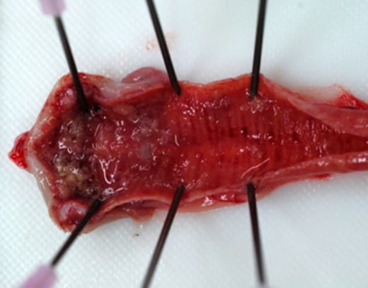
Infectious Laryngotracheitis (ILT)
(GaHV-1),)The disease is caused by gallid
alphaherpesvirus 1.

Slide 16
The primary host species for ILTV is the chicken.
The sources of ILTV are as follows:
1. Clinically affected fowls.
2. Fowls which are latent 'carriers' of infection.
3. Fomites and poultry farm personnel contaminated with ILTV

Slide 17
Natural transmission occurring by:
1. Horizontal transmission
• Direct contact with upper respiratory and discharge.
2. Vertical transmission
•
No evidence for vertical ILTV transmission to the egg or for
shedding ILTV on shells of eggs laid by infected hens.

Slide 18
Clinical Signs
Sub Acute Form
It can also be a sub acute disease with:
1. Nasal and ocular discharge
2. Tracheitis
3. Conjunctivitis
4. Mild rales

Slide 19
Clinical signs Acute Form
1. Gasping, coughing, rattling, and extension of the neck during inspiration are seen 5–12 days after natural exposure.
2. Reduced productivity is a varying factor in laying flocks.
3. Affected birds are anorectic and inactive.
4. The mouth and beak may be blood stained from the tracheal exudate

Slide 20
Mortality varies but may reach 50% in adults and is usually due to occlusion of the trachea by hemorrhage or exudate.
6. Signs usually subside after 2 weeks, although some birds may show signs for longer periods.
7. Strains of low virulence produce little or no mortality with mild respiratory signs and a slight decrease in egg production .
After recovery, birds remain carriers for life and become a
source of infection for susceptible birds, upon stress

Slide 22
PM lesions ;
The acute disease is characterized by:
1. Presence of blood, mucus, yellow caseous exudates, or a hollow caseous cast in the trachea.
2. Microscopically, a desquamative, necrotizing tracheitis is characteristic of acute disease.

Slide 23
the sub acute form:
1. Punctiform hemorrhagic areas in the trachea and larynx.
2. Mild conjunctivitis with lacrimation may be detected

Slide 24
control
implementation of biosecurity measures and vaccination.
Vaccination is done with live attenuated vaccines
and viral vector recombinant vaccines.

